Slide 1

DATA QUALITY SCORING DASHBOARD
DATA SCIENCE (24AD3107) Project Review
 | Under the Guidance of Ms. B PRATHUSHA, Assistant Professor, Department of Computer Science and Engineering, KLH CSE Bowrampet Campus
Team Members V. HARSHITH CHANDRA VARMA — 2420030020 P. POOJITH VARMA SAI — 2420030749 V. VENKATA AKHILESH — 2420030705

Slide 2
Outline of Project Work
Introduction
Literature Survey
Challenges
Research Objectives
Conclusion & Future Work
References
Publications Details

Slide 3
INTRODUCTION
Data quality is important for accurate data analysis and decision-making.
Real-world datasets may contain missing values, duplicate records, inconsistent formats and incorrect data.
Manual data-quality checking becomes difficult for large datasets.
The proposed system automatically analyzes an uploaded dataset.
It evaluates important quality parameters such as:
  Completeness
  Consistency
  Duplication
The system generates individual quality scores and an overall data-quality score.
Results are displayed through an easy-to-understand dashboard.

Slide 4
Problem Statement
Real-world datasets frequently contain:
Missing values
Duplicate records
Inconsistent data
Different data formats
Invalid or incomplete information
Manual identification of these issues is time-consuming, especially for large datasets.
Problem:
There is a need for an automated system that can analyze a dataset, identify common quality issues and generate an understandable overall data-quality score.

Slide 5
Objectives
Automatically analyse uploaded datasets.
Identify missing values and duplicate records.
Analyse data types and unique values.
Measure dataset completeness and consistency.
Calculate individual quality scores.
Generate an overall data-quality percentage.
Classify datasets into quality levels such as:
  Excellent
  Good
  Average
  Poor
Present results using a simple visual dashboard.
Help users identify areas requiring data cleaning.

Slide 6
Literature Survey
Authors (Year) | Title of the Paper | Methodology | Key Findings | Limitation / Future Work
Bayram et al. (2023) | DQSOps: Data Quality Scoring Operations Framework for Data-Driven Applications | Combines ML-based score prediction with periodic standard-based quality assessment in a DataOps workflow. | Shows that data-quality scoring can be automated for production data while reducing scoring time. | Evaluated in an industrial use case; adaptation may be needed for other domains.
Bayram, Ahmed & Hallin (2024) | Adaptive Data Quality Scoring Operations Framework Using Drift-Aware Mechanism for Industrial Applications | Uses a change-detection mechanism to monitor shifts in data quality and update scores dynamically. | Supports adaptive scoring when data characteristics change over time. | Focuses on industrial data streams; broader datasets and quality dimensions need further evaluation.
Parker et al. (2024) | Evaluating Data Quality for Blended Data Using a Data Quality Framework | Applies the FCSM data-quality framework to three health-research case studies. | Shows that data quality has multiple dimensions and that their importance depends on intended use. | Assessments can be subjective; quantitative tools and clear guidance can improve repeatability.
Yalaoui & Boukhedouma (2026) | A Structured Machine Learning Based Framework for Multidimensional Data Quality Assessment | Proposes a structured ML-based approach to evaluate multiple data-quality dimensions. | Highlights the potential of machine learning for multidimensional quality assessment. | Newly published work; further validation across datasets and real-world settings is needed.

Slide 7
Problem Gap Identification
Manual data-quality assessment requires significant effort.
Large datasets are difficult to inspect manually.
Data-quality problems may remain unnoticed before analysis.
Individual quality checks do not always provide an overall view.
Users need a simple way to understand dataset quality.
There is a need to combine data analysis + scoring + visualization into a single system.
Proposed Gap Solution:
A unified dashboard that automatically evaluates dataset quality and provides a standardized quality score.

Slide 8
Innovation, Creativity, and Novelty
Automated dataset quality assessment.
Standardized scoring approach for different quality parameters.
Overall percentage-based data-quality score.
Quality-level classification:
Excellent / Good / Average / Poor
Interactive visual representation of quality metrics.
Clear identification of detected data-quality issues.
Reduces the need for manual dataset inspection.
Can support comparison of datasets from different sources or time periods.

Slide 9
Feasibility and Project Plan
Feasibility
Easy to develop using data science and data preprocessing techniques.
Dataset can be uploaded and analyzed automatically.
Results can be displayed through a simple dashboard.
Useful for different types of datasets.
Project Plan
Dataset Collection
Data Preprocessing
Quality Issue Detection
Quality Score Calculation
Dashboard Development
Testing
Final Documentation

Slide 10
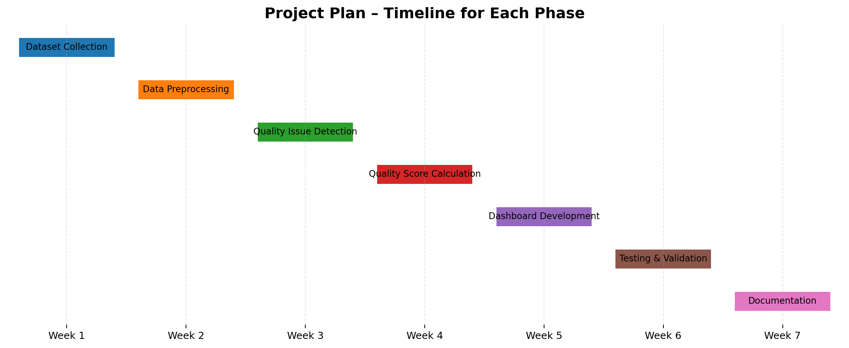

Slide 11
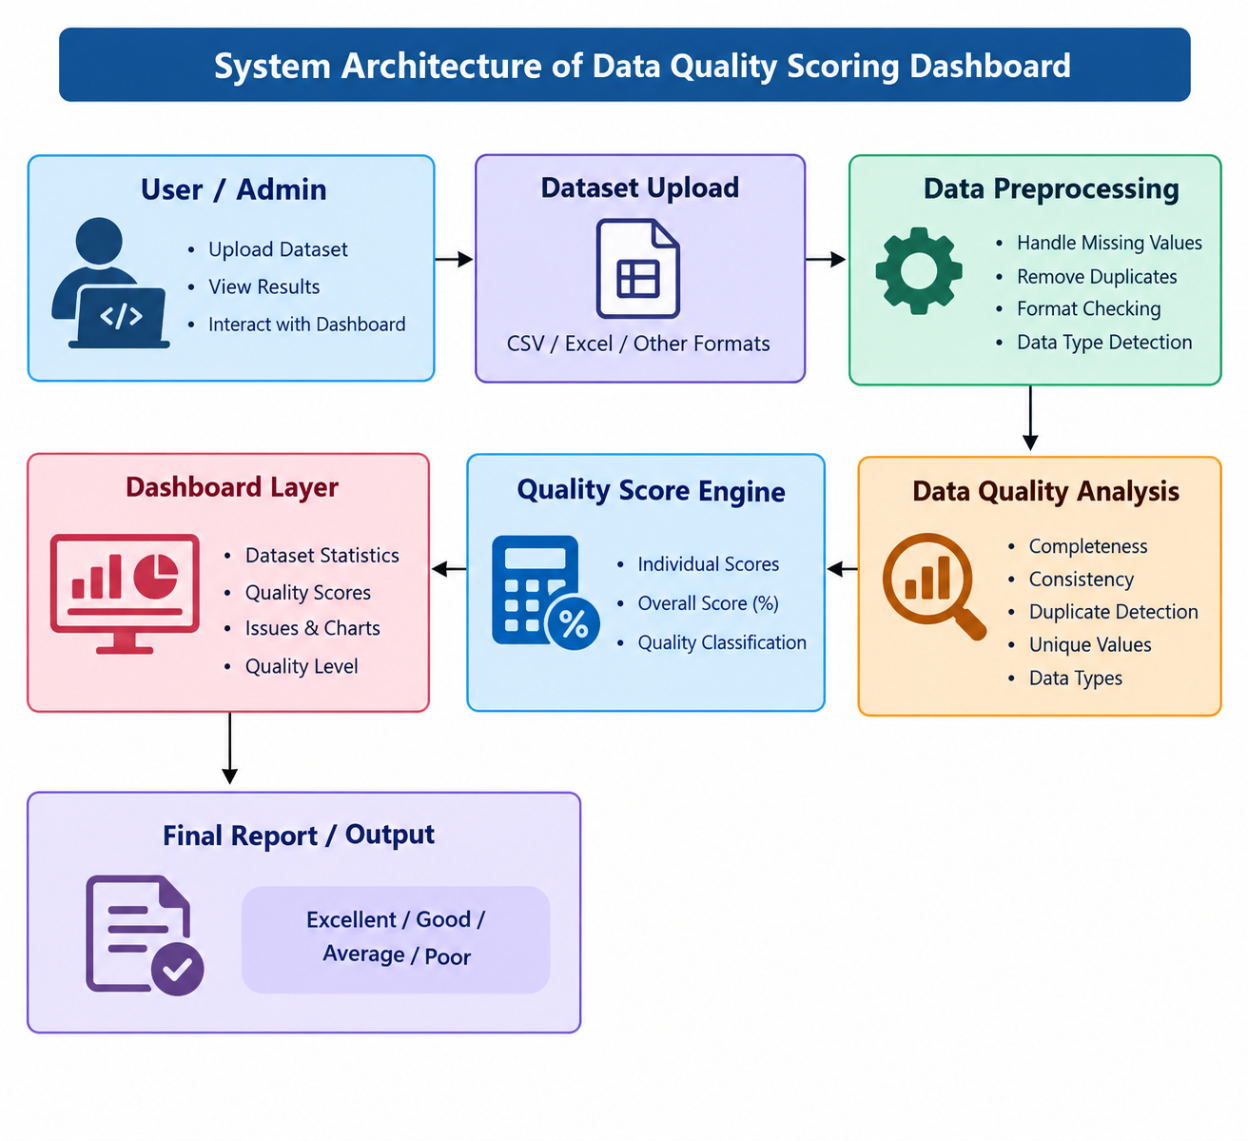

Slide 12
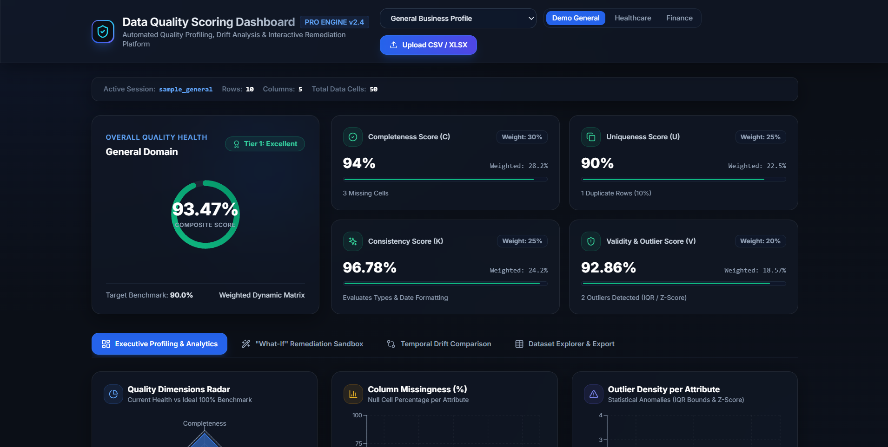
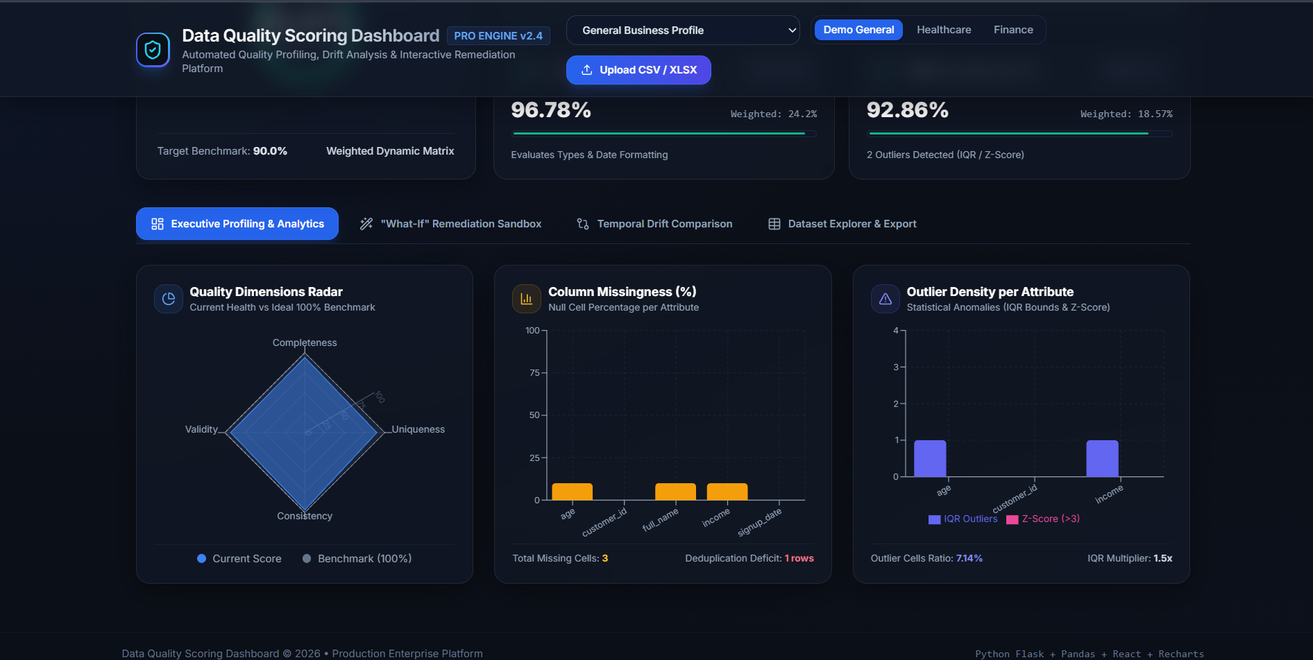
PROJECT IMPLEMENTATION
Completed dashboard interface and data-quality analytics
Dashboard Overview
Analytics & Diagnostics
Displays the composite quality score and individual scores for completeness, uniqueness, consistency, and validity.
Visualizes missing values, quality dimensions, and outlier patterns to help users locate dataset issues quickly.

Slide 13
CONCLUSION & FUTURE WORK
Conclusion
Future Work
✓
Automates dataset profiling and quality assessment.
➜
Add configurable rules for domain-specific datasets.
✓
Summarizes completeness, uniqueness, consistency, and validity scores.
➜
Support more file formats and larger datasets.
✓
Highlights missing cells, duplicate rows, and statistical outliers.
➜
Provide downloadable quality reports and cleaning suggestions.
✓
Presents results through a visual dashboard for easier interpretation.
➜
Track quality changes across repeated dataset uploads.

Slide 14
THANK YOU
Data Quality Scoring Dashboard
Automated Quality Profiling • Scoring • Visualization

